Slide 1
university of Diyala collage of Engineering
Dep. Of communication
Microwave Engineering
Lecture 1: review

Slide 2
Electromagnetic Spectrum
1.1 Applications
Band name | Abbr. | Frequency Wavelength | Example Uses
 |  | < 3 Hz > 100,000 km
Extremely Low Frequency | ELF | 3–30 Hz 100,000–10,000 km | Communication with submarines.
Super Low Frequency | SLF | 30–300 Hz 10,000–1000 km | Communication with submarines
Ultra Low Frequency | ULF | 300–3000 Hz 1000–100 km | Communication within mines.
Very Low Frequency | VLF | 3–30 kHz 100–10 km | Submarine communication, wireless heart rate monitors, geophysics
Low Frequency | LF | 30–300 kHz 10–1 km | AM long-wave broadcasting, navigation.
Medium Frequency | MF | 300–3000 kHz 1 km – 100 m | AM (medium-wave) broadcasts

Slide 3
Band name | Abbr. | Frequency Wavelength | Example Uses
High Frequency | HF | 3–30 MHz 100 m – 10 m | Shortwave broadcasts, amateur radio, aviation communications
Very High Frequency | VHF | 30–300 MHz 10–1 m | FM, television, ground-to-aircraft and aircraft-to-aircraft communications
Ultra High Frequency | UHF | 300–3000 MHz 1 m – 100 mm | Television, microwave ovens, mobile phones, wireless LAN, Bluetooth
Super High Frequency | SHF | 3–30 GHz 100–10 mm | Microwave devices, wireless LAN, most modern radars, satellite
Extremely High Frequency | EHF | 30–300 GHz 10–1 mm | Radio astronomy, high-speed microwave radio relay
 |  | Above 300 GHz < 1 mm
Microwaves

Slide 4
Electromagnetic Spectrum
1.2 Microwave Frequency Bands
Radio Waves
Designation | Frequency range
L band | 1 to 2 GHz
S band | 2 to 4 GHz
C band | 4 to 8 GHz
X band | 8 to 12 GHz
Ku band | 12 to 18 GHz
K band | 18 to 26.5 GHz
Ka band | 26.5 to 40 GHz
Q band | 30 to 50 GHz
U band | 40 to 60 GHz
V band | 50 to 75 GHz
E band | 60 to 90 GHz
W band | 75 to 110 GHz
F band | 90 to 140 GHz
D band | 110 to 170 GHz
Microwaves
T-Rays, FIR
Millimeter Waves
IR
Visible Frequencies
UV
X-Rays

Slide 5
Electromagnetic Spectrum
Industrial, Scientific, and Medical (ISM) Radio Bands
Band | Center Frequency | Band | Center Frequency
6.765–6.795 MHz | 6.780 MHz | 2.400–2.500 GHz | 2.450 GHz
13.553–13.567 MHz | 13.560 MHz | 5.725–5.875 GHz | 5.800 GHz
26.957–27.283 MHz | 27.120 MHz | 24–24.25 GHz | 24.125 GHz
40.66–40.70 MHz | 40.68 MHz | 61–61.5 GHz | 61.25 GHz
433.05–434.79 MHz | 433.92 MHz | 122–123 GHz | 122.5 GHz
902–928 MHz | 915 MHz | 244–246 GHz | 245 GHz
Microwave Ovens,
Wireless LANs,
Cordless Phones
Wireless LANs,
Cordless Phones
Microwave Ovens,
Wireless LANs,
Cordless Phones
RFID
The ISM bands are those bands originally reserved internationally for RF usage
in industrial, scientific and medical purposes other than communications.

Slide 6


Electromagnetic Wave Propagation
Guided vs. Unguided Propagation
Guided Propagation
Unguided Propagation
Propagation in the
Atmosphere
Transmission Lines,
Waveguides,
Optical Fibers, … etc.

Slide 7
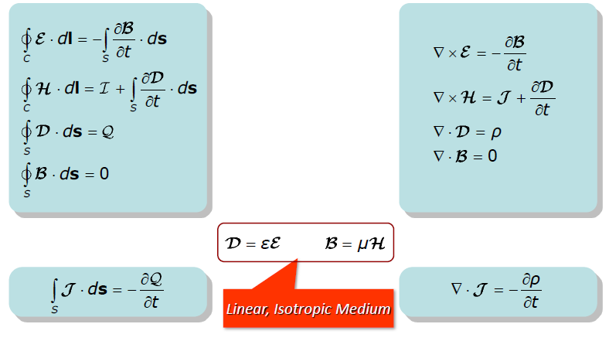
1.3 Maxwell’s Equations
Integral and Differential Forms in Time Domain

Slide 8
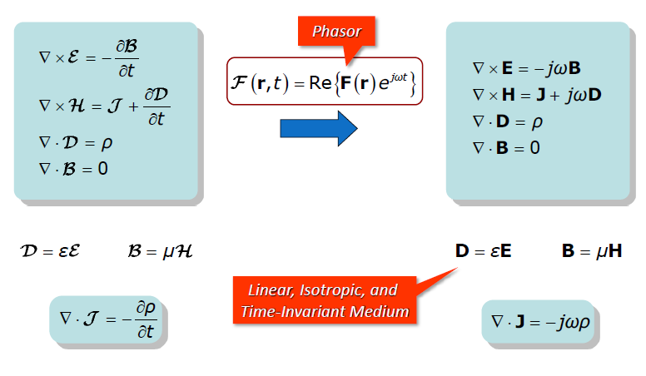
Maxwell’s Equations
Phased Analysis

Slide 9
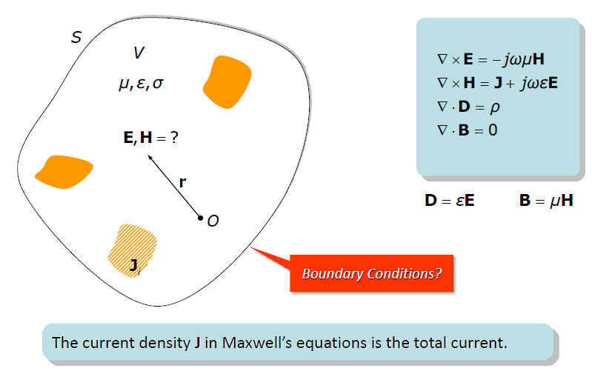
Maxwell’s Equations
Solution of Electromagnetic Problems

Slide 10
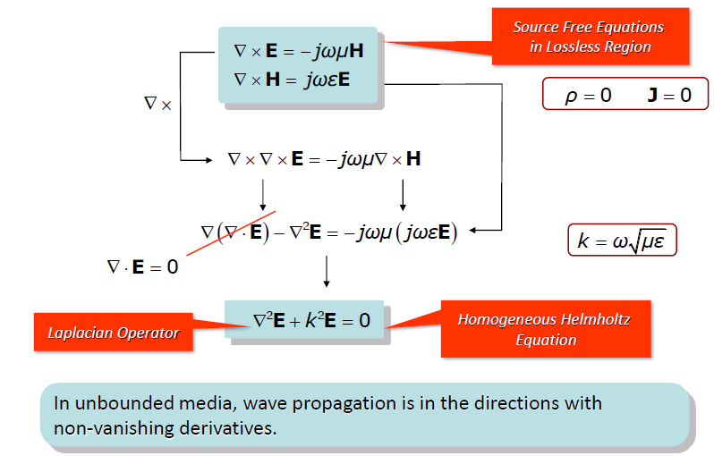
Maxwell’s Equations
Homogeneous Helmholtz Equation

